Slide 1
Hamilton County Elementary School

Slide 2
i-Ready Data

Slide 3
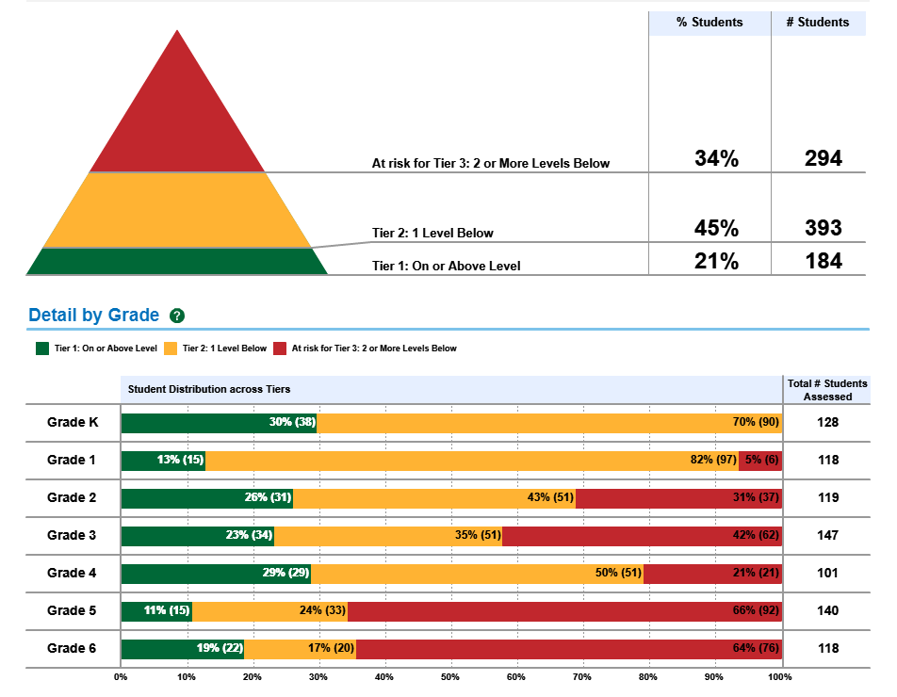
i-Ready Reading Overview

Slide 4
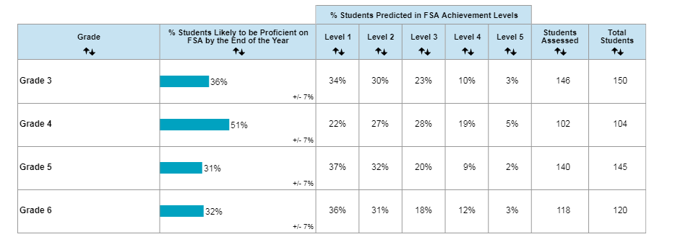
i-Ready Reading Predicted Proficiency

Slide 5
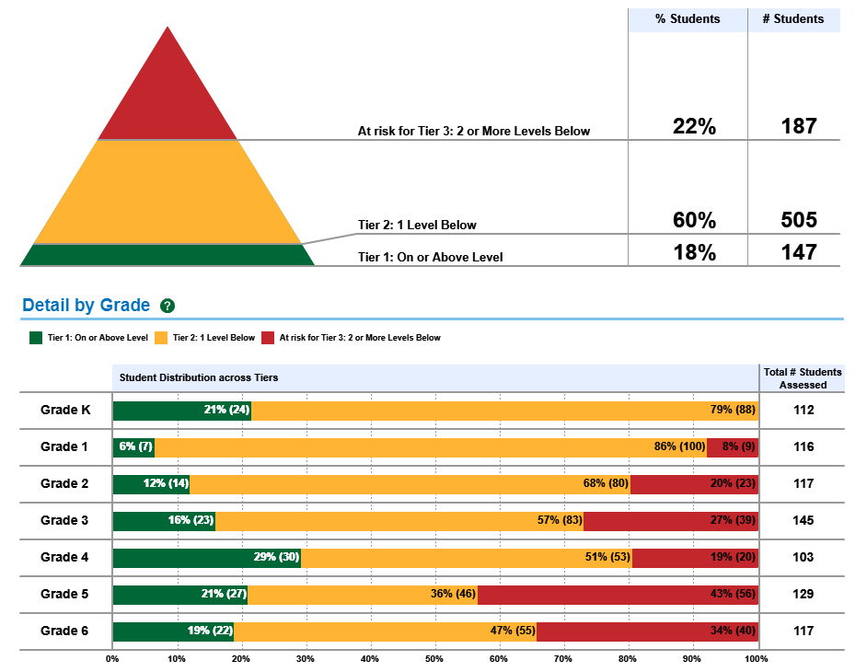
i-Ready Math Overview

Slide 6
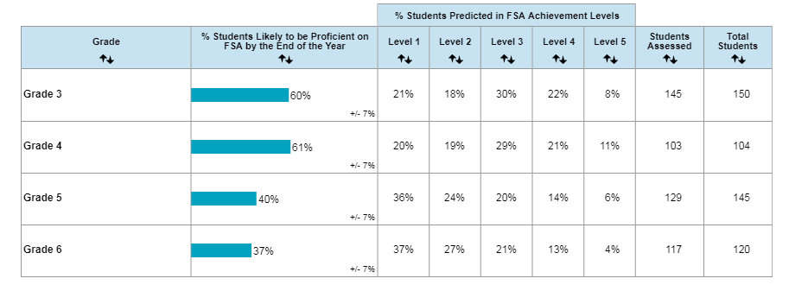
i-Ready Math Predicted Proficiency

Slide 7
STAR Data
STAR Early Literacy, STAR Reading and STAR Math

Slide 8
Kindergarten Early Literacy

Slide 9
1st Grade STAR Reading

Slide 10
1st Grade STAR Math

Slide 11
2nd Grade STAR Reading

Slide 12
2nd Grade STAR Math

Slide 13
3rd Grade STAR Reading

Slide 14
3rd Grade STAR Math

Slide 15
4th Grade STAR Reading

Slide 16
4th Grade STAR Math

Slide 17
5th Grade STAR Reading

Slide 18
5th Grade STAR Math

Slide 19
6th Grade STAR Reading

Slide 20
6th Grade STAR Math

Slide 21
Performance Matters Data
QUARTerLY BENCHMARK ASSESSMENTS

Slide 22
ELA Progress Monitoring Cut Scores

Slide 23
3RD Grade ELA Performance Matters Q1 Assessment

Slide 24
4th Grade ELA Performance Matters Q1 Assessment

Slide 25
5th Grade ELA Performance Matters Q1 Assessment

Slide 26
6th Grade ELA Performance Matters Q1 Assessment

Slide 27
Math Progress Monitoring Cut Scores

Slide 28
3rd Grade Math Performance Matters Q1 Assessment

Slide 29
4th Grade Math Performance Matters Q1 Assessment

Slide 30
5th Grade Math Performance Matters Q1 Assessment

Slide 31
6th Grade Math Performance Matters Q1 Assessment

Slide 32
Attendance

Slide 33
Attendance
259 students have missed 5 or more days
62 students have missed 10 or more days
45 students have missed 15 or more days

Slide 34
Early Warning System: Number of Students with 5 or more Days Missed

Slide 35
Discipline

Slide 36
Early Warning System: Number of Students with Referrals

Slide 37
Discipline
30 students with 1 referral
10 students with 2 referrals
5 students with 3 referrals
2 students with 4 referrals

