Slide 1
Elementary Data
“No matter what your ability is, effort is what ignites that ability and turns it into accomplishment.”
― Carol S. Dweck
December 14, 2015

Slide 2
Reading Results: District
Percentages
Reading Baseline: September 2014
Notes:
The following sides are summaries from district Istation reporting. Each slide shows the number and percentage of students at each instructional tier for the current month. Tier 1 represents proficient, Tier 2 approaching proficiency, and Tier 3 is intensive intervention is needed.

Slide 3
Reading Results: District
End of Year May 2015

Slide 4
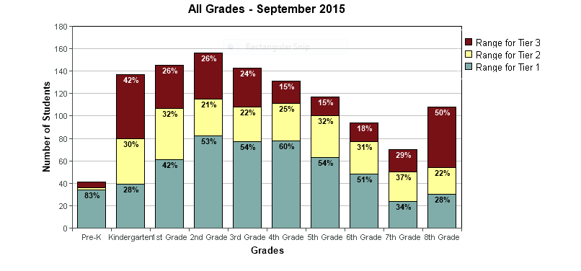
Reading Results: District
Baseline September 2015
Notes:
Istation Summary Report shows the number and percentage of students at each instructional tier for the current month.

Slide 5
Reading Results: Central
Baseline October 2015

Slide 6
Reading Results: North
Baseline October 2015

Slide 7
Reading Results: South
Baseline October 2015

Slide 8
Score Distribution: District
Pre-K
Notes:
The next set of slides break the district reading summary into grade levels. Notice the Red Expected Distribution Curve and the Green Actual Distribution Curve as we review the slides.

Slide 9
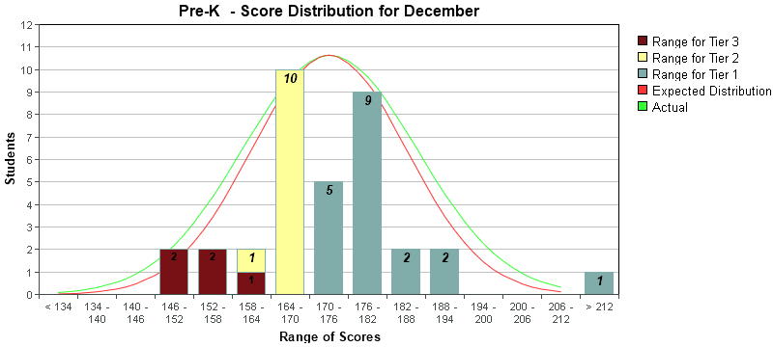
Score Distribution: District
PK moved from 83% to 86%
in tiers 1 & 2
Pre-K
Notes:
Notice the shift in the bell curve lines from October to December. There is a 3% increase in students making notable growth.

Slide 10
Score Distribution: District
Kindergarten

Slide 11
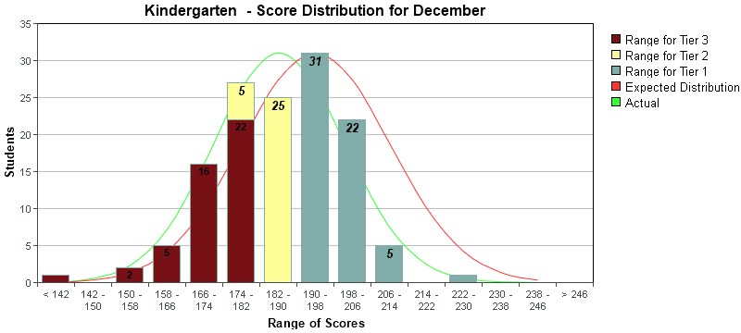
Score Distribution: District
1% growth
in tiers 1 & 2
Kindergarten

Slide 12
Score Distribution: District
First Grade

Slide 13
Score Distribution: District
16% increase of students in Tier 1
First Grade
Notes:
First grade’s data indicated a notable growth from tier 2 to tier 1. A 16% growth.

Slide 14
Score Distribution: District
Second Grade

Slide 15
Score Distribution: District
13% increase
T1 and T2
First Grade

Slide 16
Score Distribution: District
Third Grade

Slide 17
Score Distribution: District
8% decrease
Tier 3
Third Grade

Slide 18
Score Distribution: District
Fourth Grade

Slide 19
Score Distribution: District
8% increase in T2 / T1
Fourth Grade

Slide 20
Score Distribution: District
Fifth Grade

Slide 21
Score Distribution: District
Limited progression
Fifth Grade

Slide 22
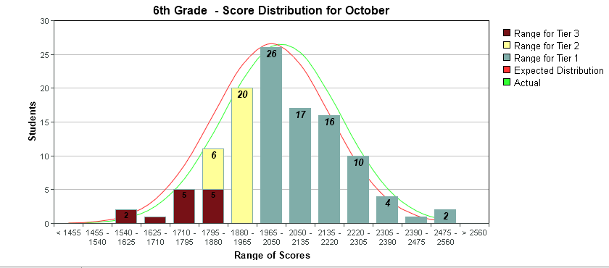
Score Distribution: District
Sixth Grade

Slide 23
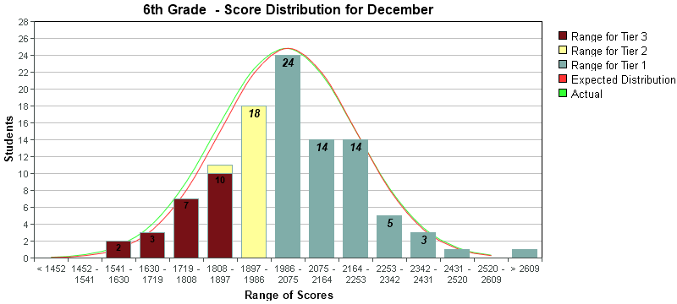
Score Distribution: District
Meeting Expectation
Sixth Grade

Slide 24
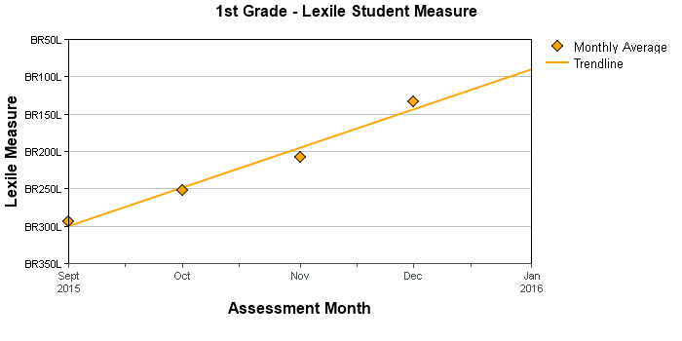
Lexile Measures: District
First Grade

Slide 25
Lexile Measures: District
Second Grade

Slide 26
Lexile Measures: District
Third Grade
Notes:
* June data indicates a student has worked on istation from home.

Slide 27
Lexile Measures: District
Fourth Grade

Slide 28
Lexile Measures: District
Fifth Grade

Slide 29
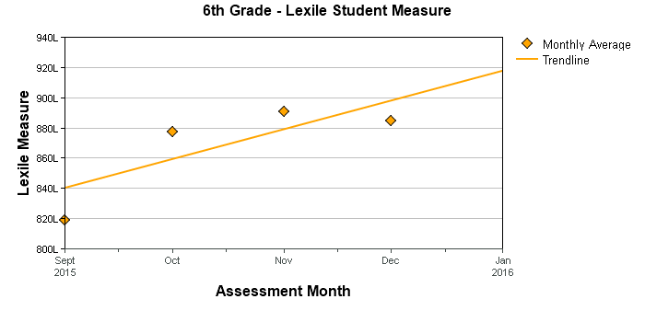
Lexile Measures: District
Sixth Grade

Slide 30
Fair: District 4th Grade Cohort AP1
3rd 2014-2015
4th 2015-2016
Fourth Grade

Slide 31
Fair: District
4th 2014-2015
5th 2015-2016
Fifth Grade

Slide 32
Fair: District
5th 2014-2015
6th 2015-2016
Sixth Grade

Slide 33
Performance Matters: District
District ELA, AP1: KG
District Math, AP1: KG
Kindergarten

Slide 34
Performance Matters: District
District ELA, AP1: 1st
District Math, AP1: 1st
First Grade

Slide 35
Performance Matters: District
District ELA, AP1: 2nd
District Math, AP1: 2nd
Second Grade

Slide 36
Math: District

Slide 37
Science: District

Slide 38
Number Students missing 10% of the school year. (9 days per 90 days)

Slide 39
Attendance Goals
20% reduction in the number of students identified for attendance issues by the Early Warning System (EWS).
2016 Interventions currently in place:
• Attendance Forms
• 5/10/15 Tracking System utilizing Skyward Reports
• Student Conferencing with 5th and 6th graders
• Parent / Teacher / Interventionist Meetings
• Academic Counseling (Recent implementation)

Slide 40
Achievement Goals: 2015-2016
100% of our students will make learning gains in ELA
100% of our students will make learning gains in Math
100% of our students will engage in Science and Social Studies

